Slide 1


Collecting Data from Twitter
Team 8
Brendan Foley
Yuhui Gong
Luis Jimenez
Mu Niu
Matt Weiss

Slide 2

Sampling Twitter Data with Streaming API

Slide 3
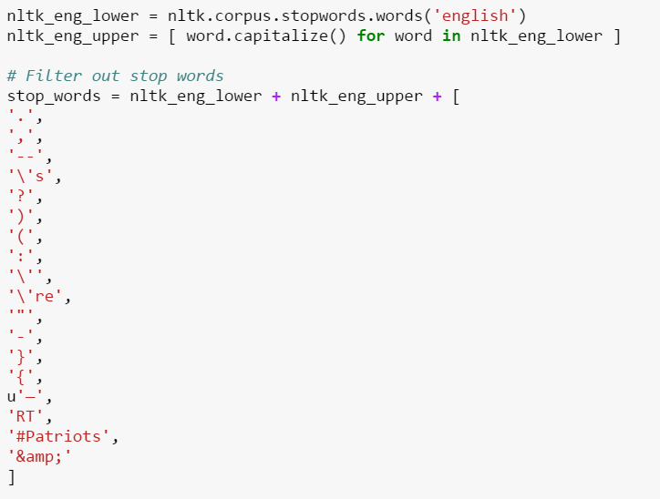
Frequency Analysis of Tweets and Tweet Entities(words)
Remove stop words

Slide 4
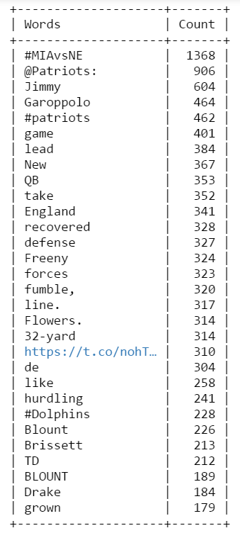
Frequency Analysis of Tweets and Tweet Entities(words)
Plot 30 most popular words

Slide 5
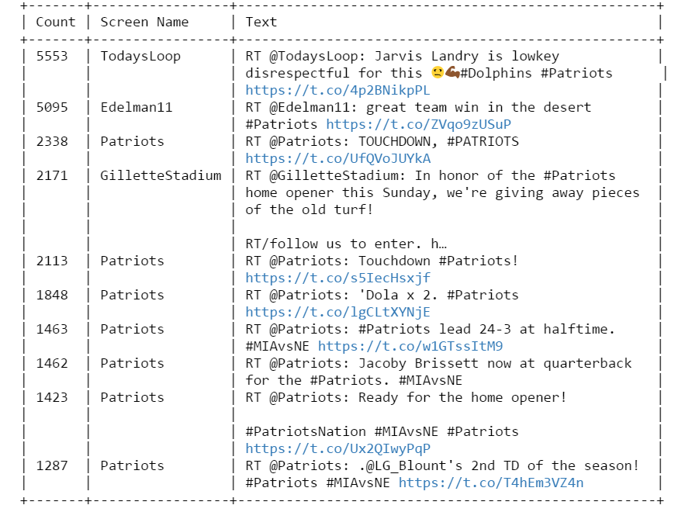
Frequency Analysis of Tweets and Tweet Entities(tweets)
List of retweet count, screen name and tweet tests.
Plot the first 10 most popular ones

Slide 6
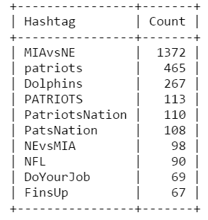
Frequency Analysis of Tweets and Tweet Entities(hashtags)
Examine all the hashtags
Plot the first 10 most popular hashtags and their counts

Slide 7
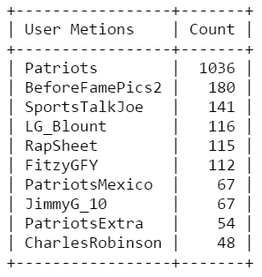
Frequency Analysis of Tweets and Tweet Entities(user mention)
Plot the first 10 most popular user mentions and their counts

Slide 8
Universe of Friends and Followers of (Jimmy Garappolo?)

Slide 9
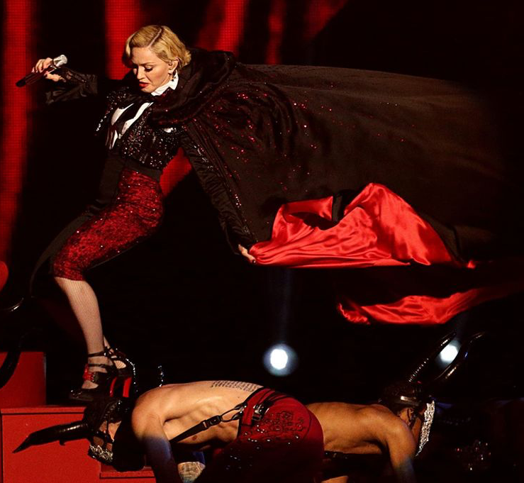
Business Application
What are the main topics and words people in the twitterverse are talking about?
Which ones can be used for an add concept for a new product launch?
London
Falling
Hilarious
Funny
Hard Day
Brits Awards
Add staring Madonna that has the motto “Falling out from a hard day” for Brookstone

Slide 10
Twitter on Business Decisions
Twitter = Opinion repository
Collection of popular opinion can help connect with the potential market.
Marketers can have live information what people are talking about.
Great source for qualitative analysis based on facts for potential concepts.

